Slide 1
CDCD Director’s address and award presentation
Dr Paul Armstrong, Director
Communicable Disease Control Directorate
13 November 2025

Slide 2
Today’s topics
Australian Centre for Disease Control
Areas of focus for 2026
  Respiratory syncytial virus (RSV)
  Measles
  Live attenuated influenza vaccine
Vaccines on the horizon

Slide 3
National activities – Australian CDC
6 November – Parliament passed the Australian Centre for Disease Control Bill 2025 (awaiting Royal Assent)
Establishes the Australian Centre for Disease Control as a statutory Commonwealth public health authority – to commence 1 January 2026
Creates functions of CDC (Director General, Advisory Council, advice to government, publishing guidelines, health promotion campaigns, promoting research)
‘Transparency framework’ – default is the publication of advice, with evidence
The Agreement Working Group will codify relationships between CWth and States
Focus areas:
  Data linkage
  ‘One Health’
  Pandemic preparedness
Precise role in immunisation unclear
Notes:
Date Linkage phases
AIHW working with CWth to link communicable disease data – AIR, PBS, MBS etc
Future phase – rapid data linkage (eg. within 48 hours) for eg, a time critical outbreak
Final phase – leveraging existing data assets and linking in with NNDSS (towards end of 2028)

Slide 4
Areas of focus in 2026
Respiratory syncytial virus (RSV)
Measles
Live attenuated influenza vaccine

Slide 5
Respiratory Syncytial Virus (RSV)
WA Health ran the most comprehensive program in Australia in 2024 and 2025
In 2025, almost 10,000 infants received Beyfortus.
  Babies born 1 Oct 2024 to 31 March 2025 - 46% of babies born were protected against RSV by either Abrysvo or Beyfortus
  Babies born 1 April 2025 to 30 September 2025 - 74% of babies born were protected against RSV by either Abrysvo (60%) or Beyfortus (14%)
Notes:
While WA wasn’t the only jurisdiction offering Beyfortus in 2024, our program was the most comprehensive. It included offering immunisations to all newborns, and Aboriginal children and those with medical risk conditions entering their second RSV season.
There has been a reduction in coverage for RSV vaccines and immunisations in 2025 compared to 2024. Is this due to provider and community complacency? Providers are ordering very similar amounts of product (vaccine and immunisation) as 2024, yet there are lower numbers reported to the AIR.
More work needs to be done in this space to increase program support offered in 2026.
The Commonwealth working on legislation to have Beyfortus on the NIP by 2027. Current limitations exist around only vaccines to be listed on the NIP.

Slide 6
Respiratory Syncytial Virus (RSV)
WA Health ran the most comprehensive program in Australia in 2024 and 2025
In 2025, almost 10,000 infants received Beyfortus.
  Babies born 1 Oct 2024 to 31 March 2025 - 46% of babies born were protected against RSV by either Abrysvo or Beyfortus (65% in 2024)
  Babies born 1 April 2025 to 30 September 2025 - 74% of babies born were protected against RSV by either Abrysvo (60%) or Beyfortus (14%) (79% in 2024)
Notes:
While WA wasn’t the only jurisdiction offering Beyfortus in 2024, our program was the most comprehensive. It included offering immunisations to all newborns, and Aboriginal children and those with medical risk conditions entering their second RSV season.
There has been a reduction in coverage for RSV vaccines and immunisations in 2025 compared to 2024. Is this due to provider and community complacency? Providers are ordering very similar amounts of product (vaccine and immunisation) as 2024, yet there are lower numbers reported to the AIR.
More work needs to be done in this space to increase program support offered in 2026.
The Commonwealth working on legislation to have Beyfortus on the NIP by 2027. Current limitations exist around only vaccines to be listed on the NIP.

Slide 7
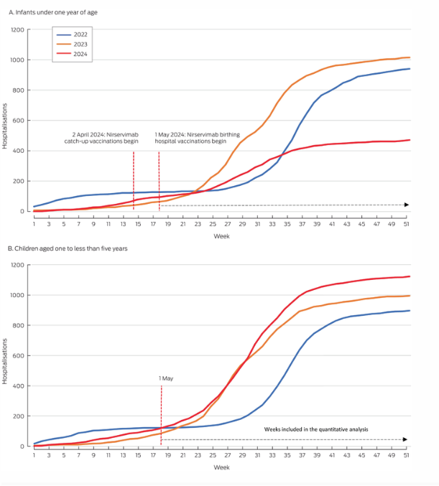
Hospitalisations due to RSV
Infants <1 year of age
Hospitalisations
Week
Children 1-4 years of age
Hospitalisations
Source: LE Blomfield et al. Med J Aust. Published online: 26 May 2025
Week

Slide 8
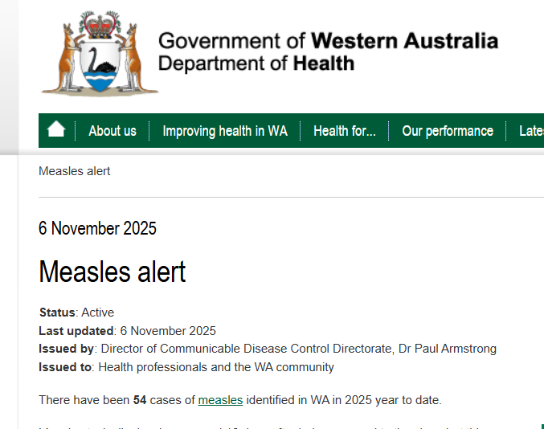
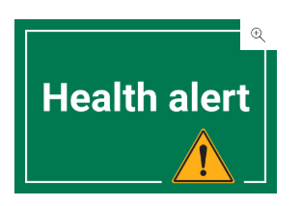
Measles
Notes:
WA is in the midst of a measles disease outbreak

Slide 9
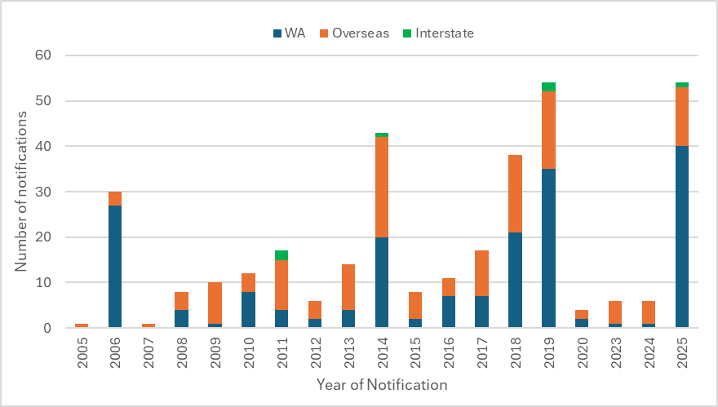
Measles
WA notifications by place of acquisition

Slide 10
Measles notifications in WA 1990 - 2012
(Notifications less reliable)

Slide 11
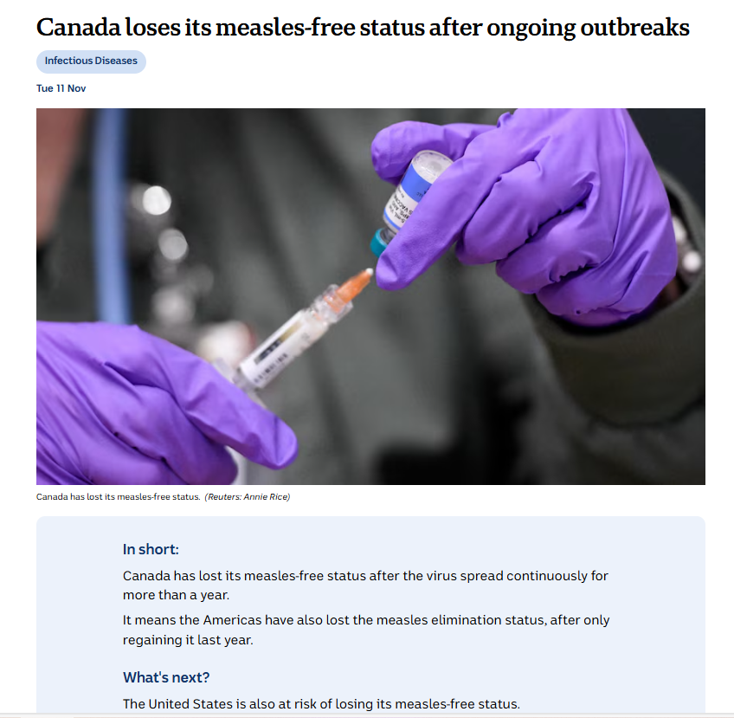
Notes:
Canada has logged 5,138 measles cases this year and two deaths.
Canada eliminated measles in 1998, followed by the United States in 2000.
The US is at risk of losing its status following a large outbreak that killed three and made nearly 1500 ill (2 Deaths) across several states this year

Slide 12
Measles vaccine eligibility-WA
The National Immunisation Program (NIP)
  children at 12 months and 18 months
Western Australian Department of Health
  individuals born after 1965 who have not already received two doses of MMR vaccine
Notes:
This slide shows the eligibility for measles vaccine in WA.
* It is important to note that infants who do receive a MMR vaccine early will still need another 2 doses of MMR after 12 months of age to ensure adequate protection.

Slide 13
Measles vaccine eligibility-WA
The National Immunisation Program (NIP)
  children at 12 months and 18 months
Western Australian Department of Health
  individuals born after 1965 who have not already received two doses of MMR vaccine
  infants aged 6 months to under 12 months, who are travelling overseas to countries experiencing a measles outbreak (after an individual risk assessment undertaken by a medical professional) or
  to infants between 6 and 12 months of age if they have recently been exposed to someone with measles while they were infectious*
Notes:
This slide shows the eligibility for measles vaccine in WA.
* It is important to note that infants who do receive a MMR vaccine early will still need another 2 doses of MMR after 12 months of age to ensure adequate protection.

Slide 14
Measles vaccination coverage in WA
90% of two-year-olds are fully vaccinated against measles.
So far in 2025, 685 infants aged under 12 months have received a dose of MMR vaccine.
So far in 2025, almost 18,000 MMR doses have been administered to WA persons aged over five years. (up from approximately 14,000 each year in 2023 and 2024)
Notes:
So, how are we doing in getting the WA community vaccinated?
90% of two-year-olds are fully vaccinated against measles.
So far in 2025, 685 infants aged under 12 months have received a dose of MMR vaccine.
So far in 2025, almost 18,000 MMR doses have been administered to WA persons aged over five years. (up from approximately 14,000 each year in 2023 and 2024)

Slide 15
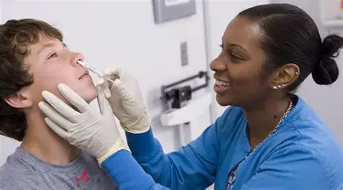
Live attenuated influenza vaccine (LAIV)
FluMist by Astra Zeneca
Program announced by Minister for Health in October 2025
2–11 year-olds in WA
Offered via primary care (Community immunisation clinics, general practice, AMSs, community pharmacies)
SASA for Community Pharmacists to be varied
Notes:
Individuals aged between 2-11 will have the option of either IM or intranasal flu vaccination in 2026
The SASA for Community Pharmacists will be amended to support vaccination via IM or intranasal influenza vaccine to those aged 2 and above for the 2026 season.

Slide 16
National Immunisation Strategy 2025-30: WA Health contributions
National Immunisation Strategy implementation plan
Area | Description
Priority Area 1 | Improve access to immunisation, with a focus on equity for Aboriginal and Torres Strait Islander people and other priority populations
Priority Area 2 | Build trust, understanding and acceptance of immunisation in communities
Priority Area 3 | Use data more effectively to target immunisation strategies and monitor performance
Priority Area 4 | Strengthen the Immunisation Workforce
Priority Area 5 | Harness new technologies to respond to the evolving communicable disease and vaccine landscape
Priority Area 6 | Implement sustainable reform in vaccine program governance, program delivery and accountability
Notes:
The WA Health Immunisation Strategy was discussed earlier today.
I will mention the National Immunisation Strategy and its implementation plan.
The National Strategy has the 6 priority areas listed in this slide. We were lucky in WA several of the priority areas overlap with our Strategy.

Slide 17
National Immunisation Strategy implementation plan
WA Health Immunisation program participated in series of workshops looking at:
  Potential activities and initiatives to address each of the six NIS 2025-30 Priority Area/s.
  The barriers that need to be addressed to progress these activities/initiatives
  The resources and mechanisms required to implement these activities/initiatives
Notes:
WA Health participated in a series of workshops hosted by NCIRS to help develop the implementation plan.
The implementation plan to support the Strategy is being finalised by the Commonwealth government but it expected to include a focus on the below areas:
Primary care
Monitoring and evaluation
Innovation
Findings were shared with the Jurisdictional Immunisation Committee Advisory Group in Oct. Next steps, Commonwealth to review and inculcate recommendations into plan.

Slide 18

Vaccines on the horizon
The Pharmaceutical Benefits Advisory Committee (PBAC)
Applications - not approved yet
  Moderna seeking NIP listing for RSV vaccine for people 75+ and Aboriginal people aged over 60
  GSK seeking reduction in age for NIP listing for Shingrix to 60
  MSD seeking NIP listing for 21v pneumococcal conjugate vaccine for older adults and Aboriginal people aged 25-49
Outcomes from July meeting
  Arexvy and Abrysvo RSV vaccine for older adults was recommended for NIP listing – no timeline provided yet
Others
  Monoclonal antibody (Beyfortus) to be added to the NIP schedule?
  COVID-19?
Notes:
In the spirit of looking forward, I will share some vaccines on the horizon for Australia. Here are some recent applications to the PBAC for addition to the NIP. Note, there has not been any decisions on these applications yet.
At the July meeting, some RSV vaccines were listed for NIP listing, but no timeline yet of when this will occur.

Slide 19
Thank you
Further queries?
Email: Immunisation@health.wa.gov.au

Slide 20

2025 Public Health Update Immunisation Awards
Notes:
These awards celebrate WA health services that have achieved outstanding immunisation coverage across Western Australia to highlight the commitment to public health and the collective effort to keep WA safe and healthy.
The awards are based on transparent and verified immunisation data and consider factors such as consistency, equity, and improvement over time, ensuring recognition goes to those who make a measurable impact.
Our goal is to encourage continued excellence, share best practices, and inspire others to prioritise immunisation for the wellbeing of all Western Australians.
Thanks Paul,
I’d like to announce the awards for the 2025 Immunisation Update. Once we announce the award, can we please have representatives come down to collect the award and have your photo taken with Paul.
The first award is for the highest vaccination rates in 2024/25 in a large SA3 area and that goes to Boorloo Public Health Unit (Bayswater-Bassendean).
The next award is for the highest vaccination rates in 2024/25 in a small SA3 area, which goes to Wheatbelt - South.
Next is the award for the most improved vaccination rates in 2024/25 for a small SA3 area, which goes to Boorloo Public Health Unit (Fremantle).
Next is the award for the area that has achieved over 95% coverage in one-year and two-year olds. This goes to Wheatbelt – South.
This award is for the area that has achieved over 95% coverage in five-year-olds, and this goes to Kimberley Public Health Unit.
And now, the Inoculate accolade award. This award is to recognise individual and team efforts by your peers. The nominees have all gone above and beyond their roles and contributed to improved team culture, leadership and of course immunisation rates.

Slide 21
Nominees for the Inoculate Accolade award
Janene Naude
Wannipa Tongrueang
Andrea Padley
Anna Moore
Deb Thomas
Pargan Sanghera
Ben Scalley
Emma McCabe
Kerry Lewis
Mirrabooka School Based Immunisation Program
Stan Perron Immunisation Centre Immunisation Team
Boorloo Public Health Unit Immunisation Team
Child and Adolescent Community Health Immunisation Team

Slide 22
Winner of the individual category
Janene Naude
Clinical Nurse Specialist/Regional Immunisation Coordinator, Southwest PHU
Sought additional funding for walk in clinics
Co-led the Understanding Parental or Carer attitudes and behaviours to immunisation in the Southwest project.
Strong advocate for the vulnerable
Notes:
Come on

Slide 23
Winner of the individual category
Ben Scalley
Created Catch up Automation Response Letter (CARL)- program enabling catch up plans in very short timeframe
Has resulted in reduced turn around time
Specifically improved efficiency of the Moorditj Kids home visiting program
Used in other settings e.g. hospitals

Slide 24
Winner of the team category
Stan Perron Immunisation Centre Immunisation Team
Nominated for outstanding delivery of 2025 Flu vaccination program at PCH
Set up pop up clinics, sent SMS messages to families with upcoming outpatient appointments
46% increase in childhood flu vaccination coverage rate from 2024
Strong staff engagement resulting in very positive family response

Slide 25
Concurrent sessions- Attendee information
Notes:
We have concurrent sessions after the break to accommodate the large number of abstract submissions this year.
The breakout room is in the seminar room just behind the back wall. This breakout room will have presentations related to Attitudes towards childhood and adolescent initiatives
Meanwhile the sessions held here in the theatrette will be for presentations related to research and evaluations
We will go straight into these sessions after morning tea.
Please remain in sessions that you choose, do not move between sessions. There will be recordings made available post event, so if you miss anything you can view it later on.
For those joining online, you will see the Teams link to the concurrent session for the seminar room in the chat. If you are joining the session in the theatrette, remain on this channel.

Slide 26

Morning tea break
We will recommence at 11.15am

