Slide 1

Developing a Scale to Measure Attitudes Towards Mandatory Vaccination
Dr Uwana Evers & Dr Joshua Lake

Slide 2
Rationale
A variety of scales exist to measure general attitudes towards vaccination and their psychological antecedents (e.g., Betsch et al., 2018, Sarathchandra et al., 2018)
However, none have been developed to specifically and comprehensively measure attitudes towards vaccination mandates
Integral to the MandEval project(Study 2)
Aims:
To develop a validated, reliable measure of attitudes towards vax mandates (for MandEval, wider use in vaccination social science, & potential generalisation/transfer to other coercive policies)
Shed light on the underlying structure of attitudes towards mandates

Slide 3
Procedure
Item generation
Cognitive interviews
Initial survey
Exploratory factor analysis
Confirmatory factor analysis
Implementation

Slide 4
1. Item Generation
Process of literature review and expert consultation and discussion
Identified 13 prospective dimensions underlying mandate attitudes
A total of 96 items were developed to comprehensively measure these dimensions (7-pt Likert)
A scenario description was also developed to capture the pandemic and mandate context
Items were refined for content validity in consultation with the expert team
75 items remained across the 13 prospective dimensions

Slide 5
1. Item Generation - Dimensions
Dimension | Example item
1. Acceptability | In the event of another pandemic occurring, I would be in favour of a mandatory vaccination policy
2. Active support | If a mandatory vaccination policy was implemented, I would be likely to express a positive opinion about it on social media
3. Compliance | If a mandatory vaccination policy was implemented, I would still try to avoid being vaccinated
4. Effectiveness | I believe that having a mandatory vaccination policy would help to control the spread of the disease
5. Evidence | For a mandatory vaccination policy to be implemented, there should be evidence that the vaccine reduces the spread of the disease
6. Expected outcomes | I believe that having a mandatory vaccination policy would help protect my family and friends from the disease
7. Rights | I believe that having a mandatory vaccination policy takes away people’s freedom to live normal lives
8. Fairness | I believe that mandatory vaccination policy would be fairer if it only imposed vaccine requirements for those at high risk from the disease
9. Sanctions | If a vaccination mandate was implemented the government should impose serious penalties for non-compliance
10. Exemptions | If a mandatory vaccination policy was implemented, there should be exemptions for religious beliefs
11. Trust | If a mandatory vaccination policy was implemented, it would reduce my trust in the government
12. Affective response | If a vaccination mandate was implemented, I would feel angry
13. Legitimacy | I believe that the government cannot legitimately require people to be vaccinated

Slide 6
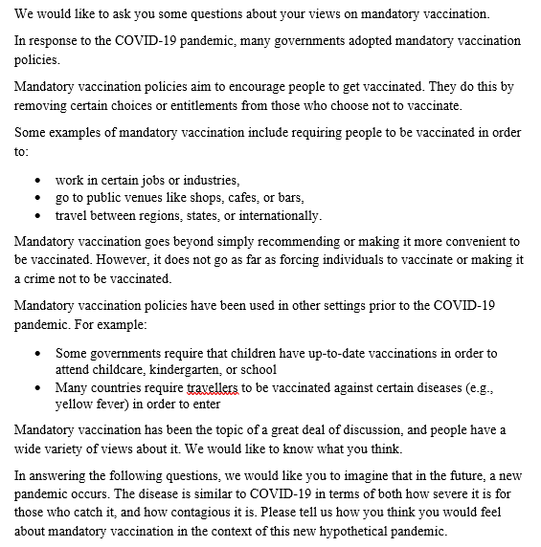
1. Item Generation - Preamble

Slide 7
2. Cognitive Interviews
Cognitive interviews were then conducted with members of the public to further refine the items
Two rounds (N=12 total)
Participants were presented the draft items and asked to read them, paraphrase each item’s meaning, and asked about how they would interpret and answer it, and the thought process(es) behind their answers
After each round of interviews, researchers’ notes and comments on responses to each question were reviewed and items were amended, added to, or removed to ensure items a) reflected the target construct(s), and b) were understood and interpreted correctly
This process resulted in a draft scale containing 59 items after round 1, further refined to 55 items after round 2

Slide 8
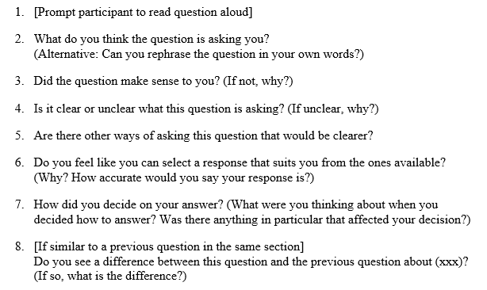
2. Cognitive Interviews – question guide

Slide 9
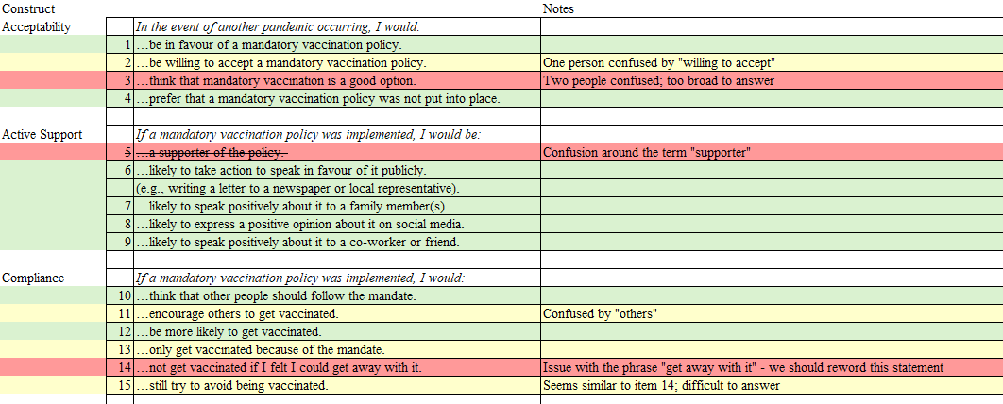
2. Cognitive Interviews – example research team notes
NB. notes are derived / aggregated from interview notes; not original interview notes

Slide 10
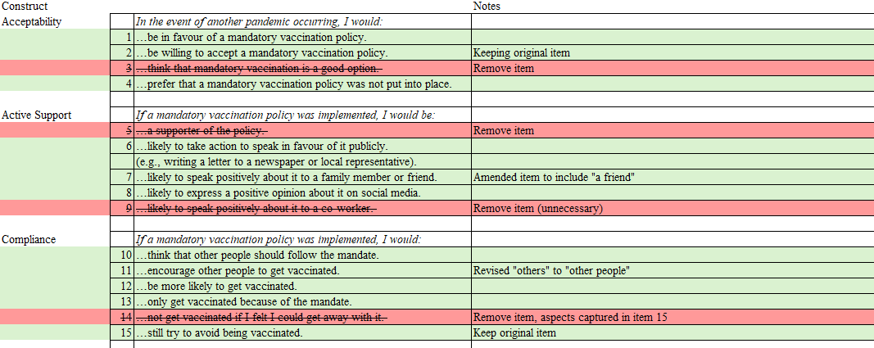
2. Cognitive Interviews – example revision notes

Slide 11
3. Initial Survey
The draft scale (55 items) was then programmed into a Qualtrics survey
Demographic questions and other measures of vaccination attitudes and behaviour (for validation) were also included
Dimensions were presented in random order; scale items were randomized within dimensions
Survey was administered to a general population sample of Australian adults (N=1007)
The sample was split in two randomly, with half (n=504) being used to conduct exploratory factor analysis, and the other half (n=503) to conduct confirmatory factor analysis

Slide 12
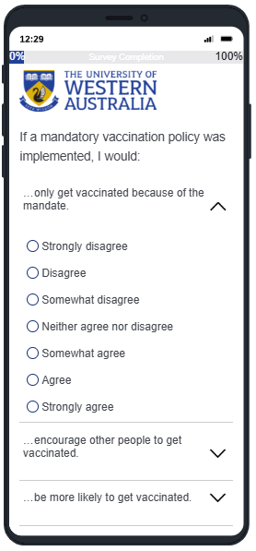
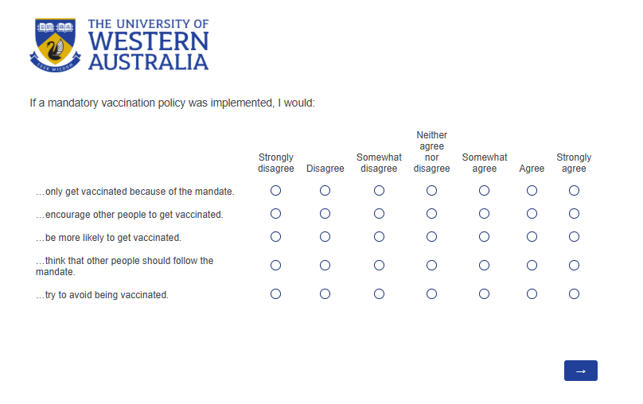
Example Qualtrics from survey

Slide 13
4. Exploratory Factor Analysis
EFA Conducted in SPSS (n=504)
Negatively worded items were reverse-coded (NB. only changes valences of results / interpretation)
Iterative process; multiple rounds of analysis and item reduction/refinement
Maximum likelihood model; direct oblimin rotation
Two-dimensional structure of vaccination mandate attitudes was identified
Final (draft) version of the mandate attitudes scale was established and validated, containing 10 items.

Slide 14
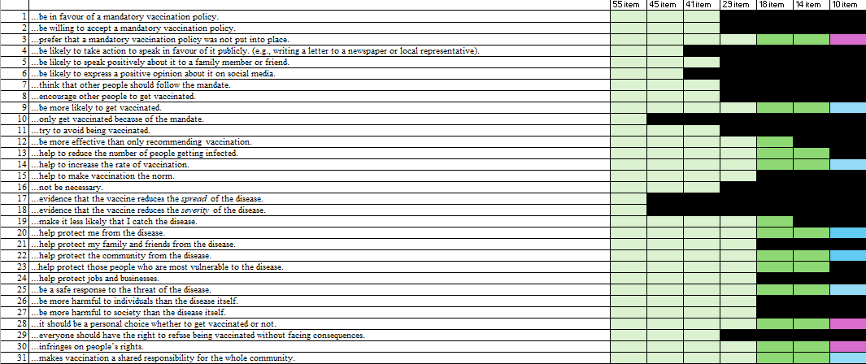
4. Exploratory Factor Analysis –
Item Reduction List Example

Slide 15
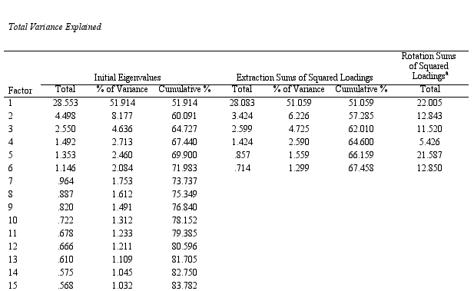
4. Exploratory Factor Analysis –
55 items (extracting eigenvalues >1)

Slide 16
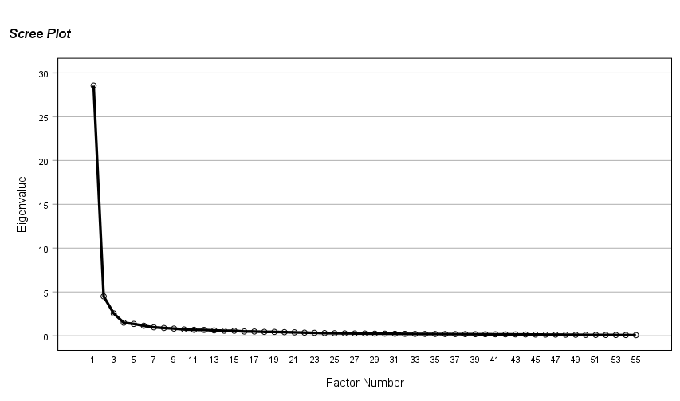
4. Exploratory Factor Analysis –
55 items

Slide 17
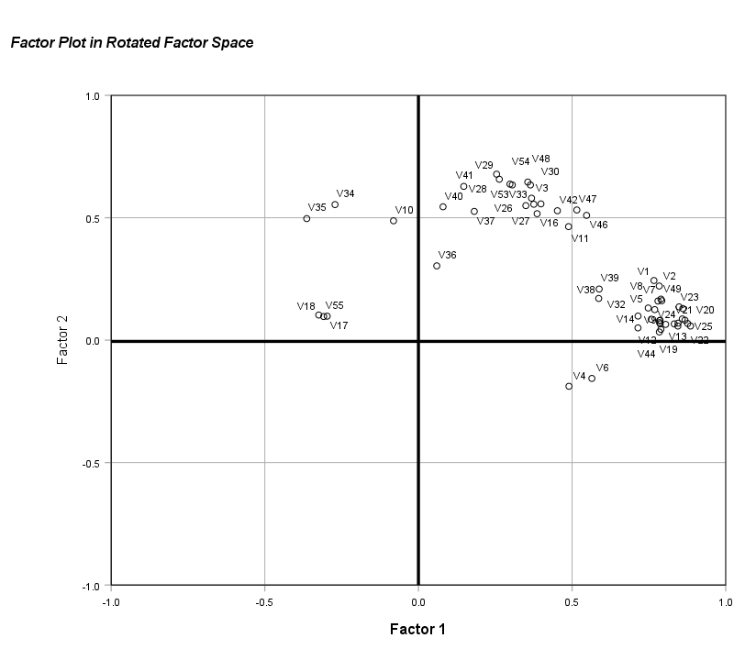
4. Exploratory Factor Analysis –
55 items, 2 factor solution

Slide 18
4. Exploratory Factor Analysis –
55 items, 2 factor solution
Exemptions
Rights/limitations/choice
Only vax bc of mandate
Penalties and enforcement
Limiting who is mandated
Financial benefits/penalties
Protection/perceived benefits
Evidence & free vaccines
Expressing positive opinions

Slide 19
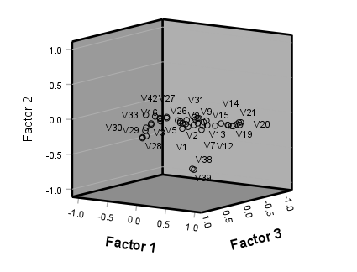
4. Exploratory Factor Analysis –
45 items, 3 factor solution

Slide 20
4. Exploratory Factor Analysis –
45 items, 3 factor solution
Penalties and enforcement

Slide 21
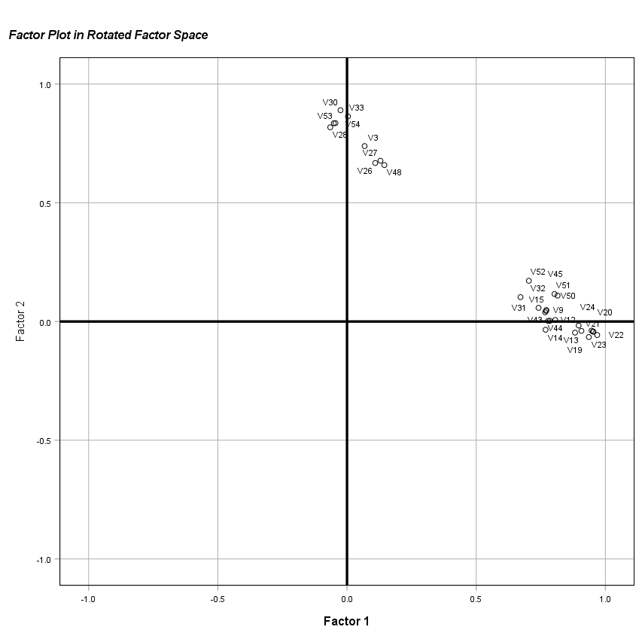
4. Exploratory Factor Analysis –
29 items, 2 factor solution

Slide 22
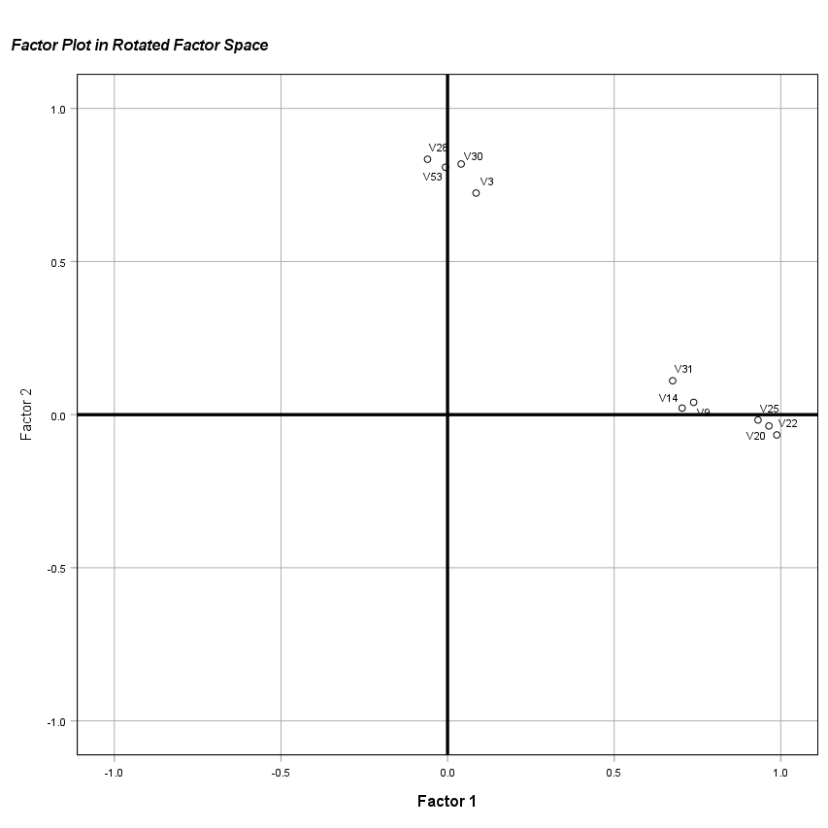
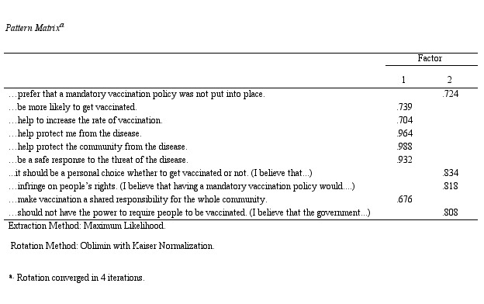
4. Exploratory Factor Analysis –
10 items, 2 factor solution

Slide 23
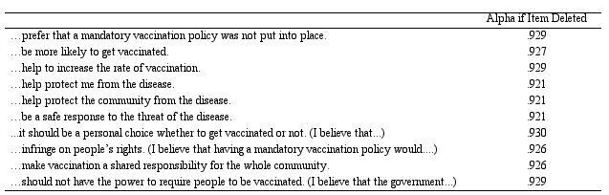
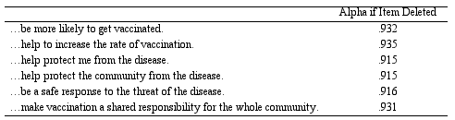
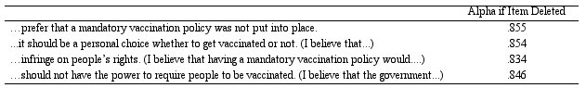
4. Exploratory Factor Analysis – Reliability
Scale alpha = .933
Factor 1 alpha = .936
Factor 2 alpha = .881

Slide 24
5. Confirmatory Factor Analysis
Conducted using SPSS AMOS (n=503)
As expected, a two (correlated) factor model demonstrated good model fit, and was superior to a single-factor model
Fit index | 2F Model | 1 Factor | Benchmark (Wood et al., 2008)
Chi-squared | 98.66*** | 529.65*** | (N/A)
SRMR | .08 | .29 | .08 (max)
Comparative fit index | .98 | .88 | .95 (min)
RMSEA | .06 | .17 | .06 (max)

Slide 25
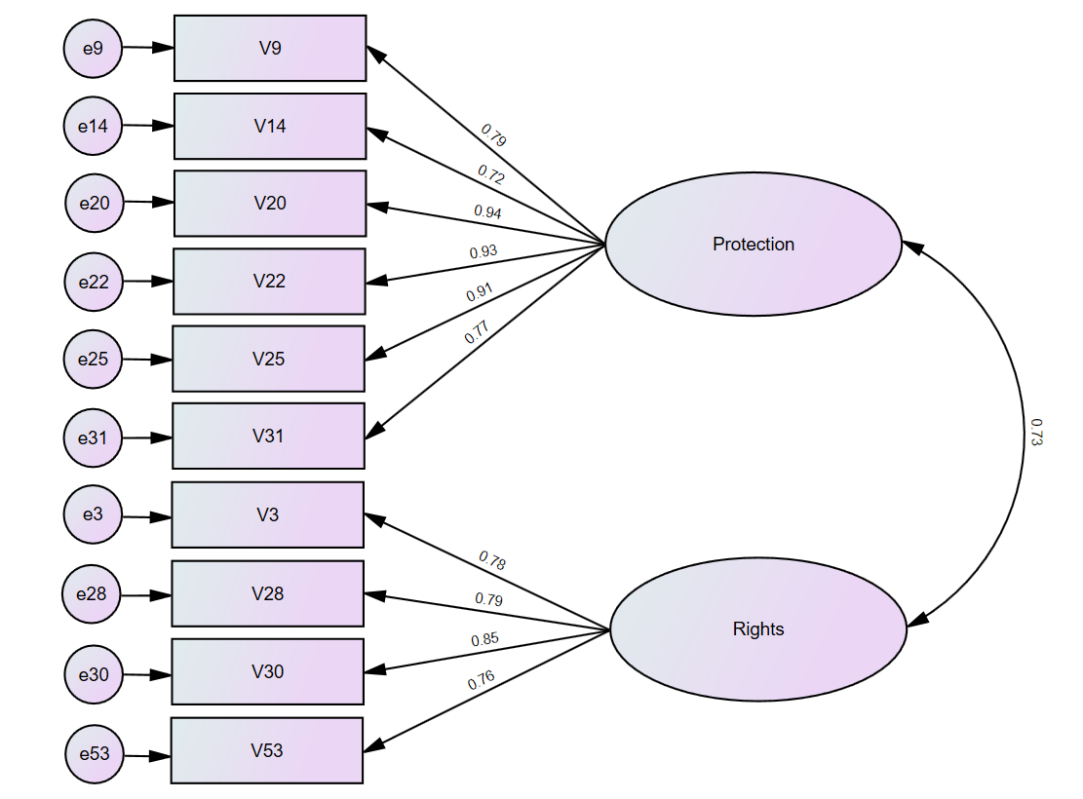
5. Confirmatory Factor Analysis

Slide 26
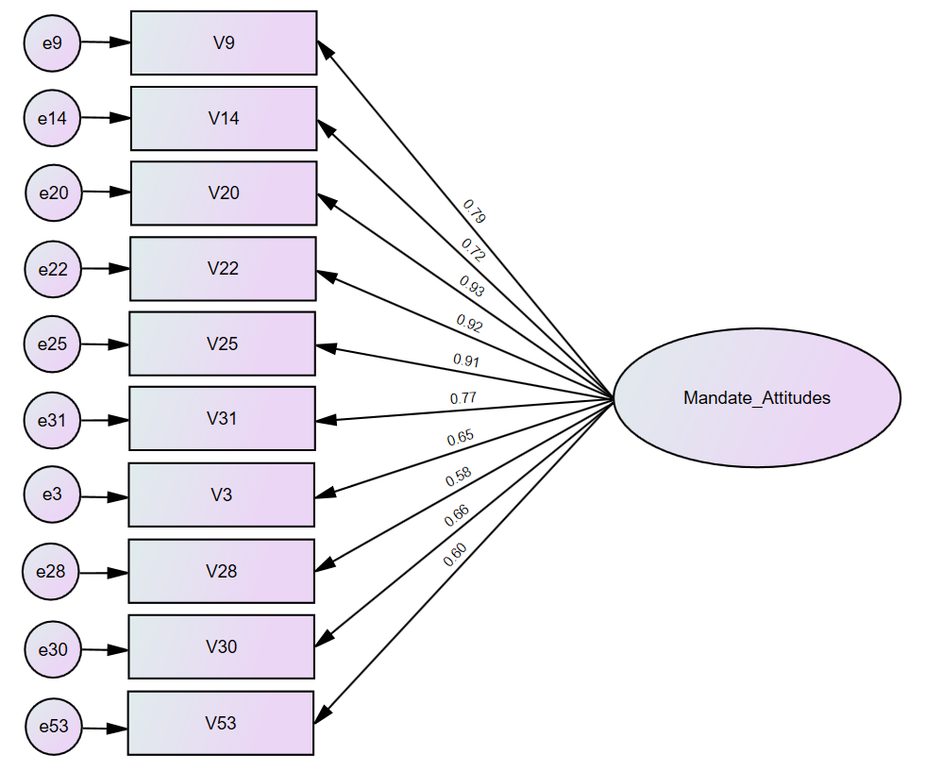
5. Confirmatory Factor Analysis

Slide 27
Final Measure – Vaccination Mandate Attitudes Scale (VMAS)
Item | Wording | Factor
A mandatory vaccination policy would…
VMAS_1 | …help to increase the rate of vaccination | 1 (“Protection”)
VMAS_2 | …help protect me from the disease | 1 (“Protection”)
VMAS_3 | …help protect the community from the disease | 1 (“Protection”)
VMAS_4 | …be a safe response to the threat of the disease | 1 (“Protection”)
VMAS_5 | …infringe on people’s rights | 2 (“Rights”)
VMAS_6 | …make vaccination a shared responsibility for the whole community | 1 (“Protection”)
Please indicate how strongly you agree or disagree with the following statements.
VMAS_7 | I would prefer that a mandatory vaccination policy was not put into place | 2 (“Rights”)
VMAS_8 | If a mandatory vaccination policy was implemented, I would be more likely to get vaccinated | 1 (“Protection”)
VMAS_9 | It should be a personal choice whether to get vaccinated or not | 2 (“Rights”)
VMAS_10 | Government should not have the power to require people to be vaccinated | 2 (“Rights”)

Slide 28
6. Implementation
The VMAS has been included in the main MandEval Study 2b survey (currently at field) (4000 adults in each of Australia, France and Italy)
An adapted version to measure perceptions of others’ attitudes is also included
The survey also includes a range of measures of personality, culture, political preference, vaccination attitudes, behaviours, and experiences (incl. COVID), and demographic variables

Slide 29
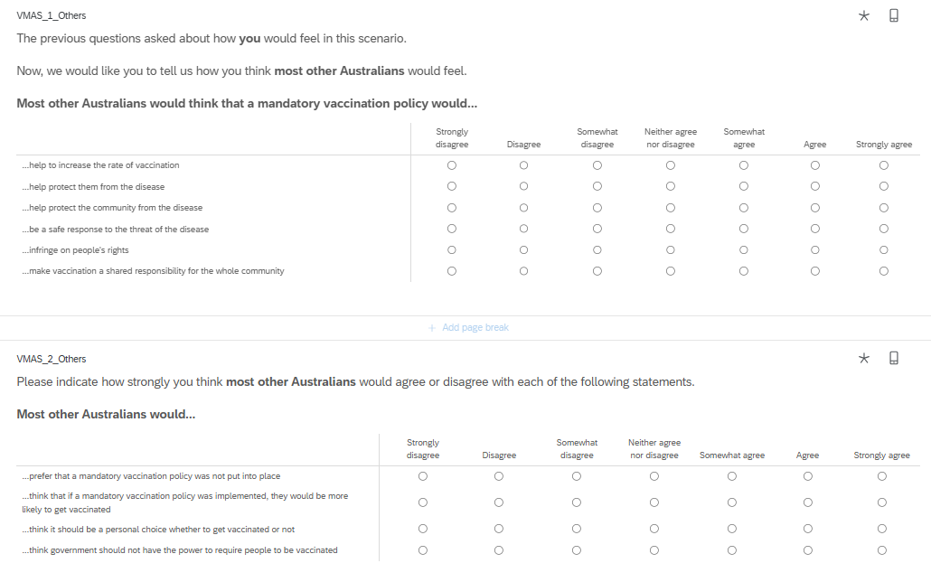

Slide 30
6. Implementation
Paper plan:
Scale development paper (multi-study; development and descriptives)
Personal values and mandate attitudes
Personality profiles and mandate attitudes (cluster/segmentation analysis)
Cultural and normative influences on mandate attitudes (MLM)
Political preferences and attitudes towards mandatory vaccination (network analysis)
Future application and adaption potential of the VMAS
Existing data from initial survey (55 VMAS draft items, vaccine attitude and behaviour questions, and demographics) is also available for analysis - see data dictionary

Slide 31
Any questions?

Slide 32




















