Slide 1
WA Immunisation Strategy 2024-2028
Rebekah Hart
Principal Policy Officer
Policy, Planning and Projects Team
Immunisation Program, Communicable Disease Control Directorate
Thursday 13 November | Public Health Update, Department of Health
Classification: Official
Notes:
Thank you Jo-Anne for an excellent presentation, and leading the significant work that the Program has undertaken in 2025.
My name is Rebekah Hart and I work closely with Jo-Anne on all things strategy and policy in the Immunisation Program. It is my pleasure to give a presentation today on the Western Australian Immunisation Strategy 2024-2028.

Slide 2
Purpose of this presentation
Overview of the WA Immunisation Strategy 2024-2028
Monitoring and reporting framework for the WA Immunisation Strategy 2024-2028
What implementation monitoring has revealed thus far
Notes:
The purpose of this presentation is to provide an overview of the WA Immunisation Strategy 2024-2028, with a focus on the new implementation and monitoring framework.
I will address why the framework was introduced and what is being monitored
I will also provide a brief summary of what implementation monitoring has revealed thus far and how implementation monitoring will guide activities in 2026

Slide 3

Strategy vision and aims
The vision of this Strategy is ‘for every individual, in every community, at every stage of life, to confidently engage with immunisation, supporting robust health for all Western Australians.’
Aims to reduce the incidence of, or maintain elimination of, vaccine-preventable disease (VPDs) by: ​
improving immunisation access, acceptance, and increase demand and uptake ​
enhancing the systems that provide and support immunisation service delivery. ​
Notes:
The overarching vision of this strategy is for every individual, in every community, at every stage of life, to confidently engage with immunisation, supporting robust health for all Western Australians. Press enter.
The strategy aims to reduce the incidence of, or maintain elimination of, VPDs by: ​
improving immunisation access, acceptance, and increase demand and uptake, and ​
enhancing the systems that provide and support immunisation service delivery. ​
The strategy gives immunisation stakeholders clear direction by identifying 5 priority areas.

Slide 4
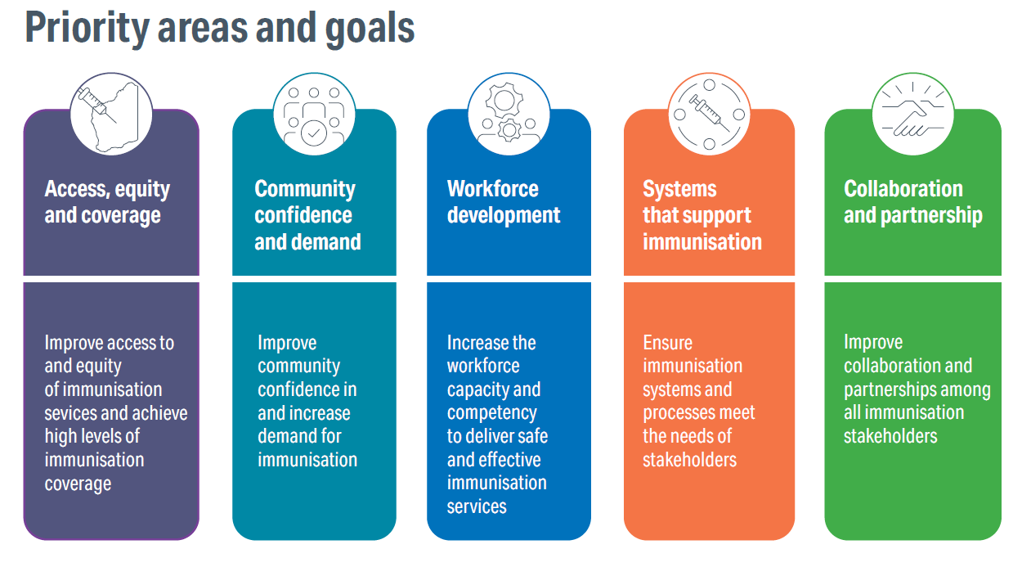
The 5 Priority Areas
Notes:
So, what are the 5 priority areas? Press enter
Priority Area One – Access, equity and coverage
I like to think of this as the core priority area of the Strategy.
The focus is on achieving high levels of coverage where individuals, regardless of their background, social conditions, or geographic location, can readily, flexibly and safely access immunisation services. Press enter.
The goal is to improve access and equity of immunisation services to achieve high levels of immunisation coverage. Press enter.
Priority Area Two – Community confidence and demand
The aim is to establish widespread confidence and demand for immunisation across all communities, where decisions are shared, engagement and dialogue is meaningful, and information is transparent, accurate and accessible. Press enter.
The goal is to improve community confidence and increase demand for immunisation. Press enter
Priority Area Three – Workforce Development
Priority area 3 aims to achieve a highly skilled, competent, equipped and resilient immunisation workforce, ensuring that every professional is empowered with the knowledge, skills, and support to effectively deliver safe, effective, and inclusive immunisation services. Press enter
The goal of this one is to increase workforce capacity and competency to deliver effective immunisation services.Press enter
Priority Area Four – Systems that support immunisation
This priority aims to ensure policies, processes and information systems supporting immunisation are fit-for-purpose and readily adaptable to current and evolving public health challenges. Press enter
The goal of priority area four is to ensure immunisation processes and information systems meet the needs of stakeholders Press enter
Priority Area Five – Collaboration and partnership
This priority supports impactful and sustainable collaborations and partnerships among stakeholders to improve immunisation services. Press enter
The goal of this priority is to improve collaboration and partnerships among immunisation stakeholders.
Each of the priority areas are underpinned by strategic objectives and actions to support the achievement of the strategic goals. These were developed in conjunction with key immunisation stakeholders through the consultation process.

Slide 5
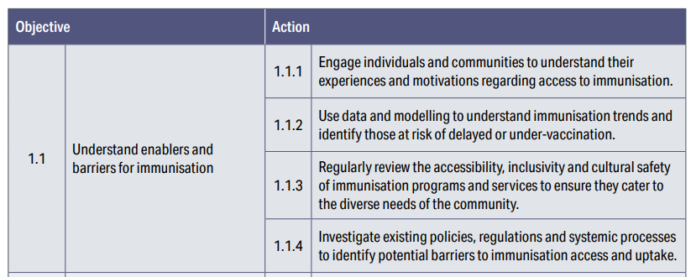
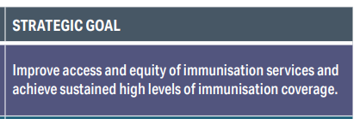
Strategic goals, objectives, and actions Example: Priority Area 1
Notes:
To demonstrate how each strategic goal is linked to objectives, and actions we’ll take a look at Priority Area 1.
This priority area has 3 objectives, each of which have their own actions, here on the screen you can see the actions assigned to the strategic objective to ‘understand enablers and barriers to immunisation’. These actions provide direct guidance to immunisation stakeholders as to how they can implement the strategy.

Slide 6
Priority populations & settings
Priority populations
Children
Adolescents
Aboriginal people
Pregnant women
Health care workers
People from CaLD backgrounds
Transient groups
Older people
People living with disability
People with medical risk conditions
Priority settings
Established settings
- Primary health services
- In-reach settings
- HSP inpatient and outpatient settings
Settings that require tailored approaches
- Congregate living
- Low coverage areas
- Out-reach settings
Notes:
This strategy is designed to protect all individuals and the community from VPDs, at every stage of life. However, the department recognises the following groups are either disproportionately or more severely affected by VPDs, face significant barriers to accessing immunisation services, or have seen declining immunisation rates in recent years. These are our priority populations, as listed on the screen.
Press enter
In WA, immunisation services are provided across a range of settings. This strategy identifies that continued support is required for established settings, as well as for settings that require tailored approaches. These are our priority areas, as listed on the screen.

Slide 7
Aboriginal Immunisation Implementation Guideline
The Strategy aims to improve immunisation outcomes for Aboriginal people
Workshop identified key actions for the guideline
The Aboriginal Immunisation Implementation Guideline is under development.
Notes:
This strategy aims to improve immunisation outcomes for Aboriginal people and acknowledges that Aboriginal health is everyone’s business.
The needs of Aboriginal people across WA are encouraged to be embedded into activities in each priority area.
Workshop held in June with Aboriginal health stakeholders identified key actions for the guideline.
The Guideline is currently under development.

Slide 8
How do we achieve the Strategy’s goals?
Immunisation stakeholders implement strategic actions
Department of Health monitors implementation
Strengths and areas of growth are identified
Stakeholders adjust activities accordingly
Sustained progress continues
Notes:
So, how do we achieve the Strategy’s goals? Press enter twice.
Key immunisation stakeholders are required to implement strategic actions by embedding them into their workplans. Press enter.
The Department of Health then monitors implementation. Press enter.
Areas of strength and growth are identified across the system. Press enter.
Based on this, stakeholders may adjust activities accordingly, or where projects are successful, they remain ongoing. Press enter.
Through this process, we as a system, ensure that sustained progress can continue. This strategy’s monitoring and reporting framework provides structure for mechanisms that support implementation.

Slide 9
What is the monitoring and reporting framework?
There are 2 components to the framework:
Implementation monitoring - how organisations are implementing the Strategy
Outcome reporting - what has changed since the implementation of the Strategy
System-level oversight of implementation, especially for priority populations and settings.
Notes:
So, what is the monitoring and reporting framework? Press enter.
There are 2 components of the monitoring and reporting framework: Implementation monitoring allows the department to investigate how organisations are implementing the Strategy
Outcome reporting allows the department to monitor what has changed since the implementation of the Strategy. Press enter.
The framework enables system-level oversight of activities, by ensuring all priority populations and settings are being captured, and that each priority area is being implemented. Press enter.

Slide 10
How is implementation monitoring conducted?
Stakeholders report activities
Implementation monitoring report tabled WA Immunisation Advisory Committee (WAIAC)
Actions for WAIAC members derived from recommendations
CDCD collates reports, develop recommendations
Aboriginal Immunisation Network Steering Committee (AINSC)
Feedback provided to WAIAC
Notes:
How is implementation monitoring conducted? Press enter.
Biannually, we invite stakeholders to report activities against the strategic actions.
These stakeholders include, but are not limited to:
Child and Adolescent Health Service
Communicable Disease Control Directorate, here are the department
Western Australian Country Health Service
North Metropolitan Health Service
Western Australian Primary Health Alliance Press enter.
CDCD collates these reports, summarises observations, and develops recommendations. Press enter.
The output of this is the implementation monitoring report, which is tabled at the WA Immunisation Advisory Committee meeting. Press enter.
Actions for the members are derived from the report’s recommendations. Pres enter.
Additionally, the Aboriginal Immunisation Network Steering Committee provides feedback to the WAIAC on activities targeted toward Aboriginal people. Press enter.

Slide 11
What is outcome reporting?
Annually, key performance indicators (KPIs) will be reported against
Allows progress to be monitored over time
35 KPIs were developed, aligned to the 5 priority areas
First Annual Strategy Progress Report in 2026.
Notes:
What is outcome reporting?
Outcome reporting is the process by which the department will annually coordinate measurement of progress against the Strategy’s key performance indicators (KPIs). Press enter.
Outcome reporting allows progress to be monitored over time. Press enter.
35 KPIs were developed to evaluate progress toward the achievement of strategic goals, and are aligned to each priority area. Each KPI has a target for 2025, 2026, 2027 and 2028. These targets aim to drive sustained progress against the goals of the Strategy. A full list of the KPIs and targets can be viewed in the Strategy. Press enter.
First Annual Strategy Progress Report, which is the output of the Outcome reporting report produced in 2026. Press enter.

Slide 12
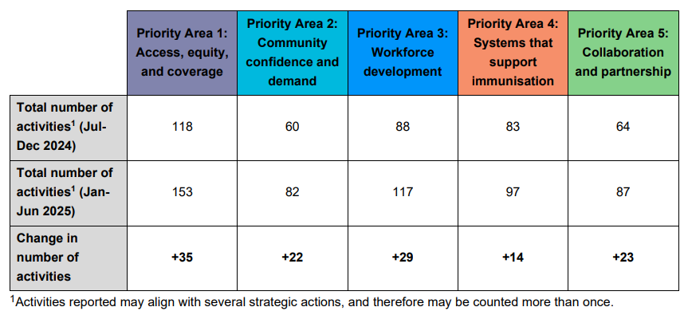
What has implementation monitoring revealed thus far?
2 periods of reporting
87 activities Jul-Dec 2024
240 activities Jan-Jun 2025
Priority Area 1 most activities
Additional reporting stakeholder in second round
Table 1. Comparison of activity counts by priority area across 2 reporting periods
Notes:
So, what has implementation monitoring revealed thus far?
Over the 2 periods of reporting from and
187 activities reported in total in July-December 2024, and 240 activities from January-June 2025 the second period. It is important to note that some activities reported may align with several strategic actions and therefore may be counted more than once.
We observed an increase in activities across all priority areas, with majority of new initiatives being made under priority area 1, as can be seen in table 1 on the screen.
In the second round of reporting WAPHA also came on board as a reporting stakeholder, which contributed to some of the additional reports.
Press enter.

Slide 13
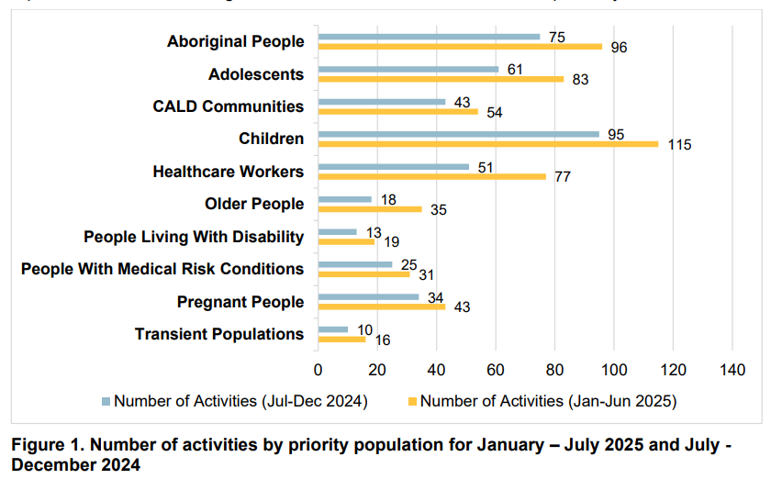
Implementation monitoring: Priority populations
Majority of activities = Aboriginal people, children and adolescents
Least activities = transient populations and people living with disability
Older adults require more targeted initiatives in 2026
Notes:
In relation to priority populations, majority of activities reported were for tailored initiatives for Aboriginal people, children, and adolescents, as we can see in Figure 1. This is a positive indicator that as a system we are directing our resources towards the target groups that have seen notable declines in recent years, and that we are improving access for these cohort.
In contrast, transient populations and people living with disability have the least amount of activities, monitoring of these activities will ensure that these cohorts continue to be prioritised.
Whilst older adults do not have the least amount of activities, given the risk of severe illness in this group associated with VPDs, the relatively low number indicates that more could be done for this cohort.
Press enter.

Slide 14
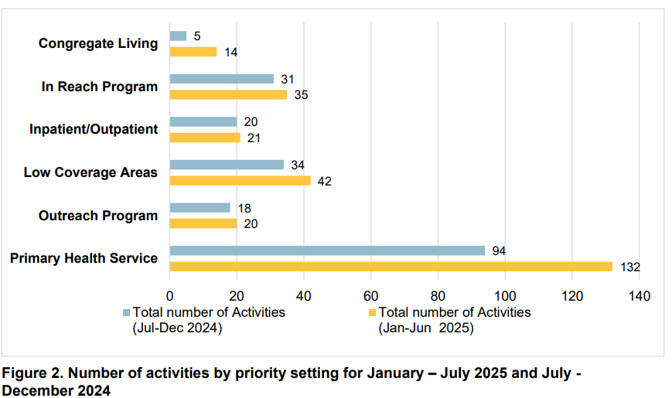
Implementation monitoring: Priority settings
Majority of activities = primary health services
Least activities = congregate living
Congregate living settings require additional focus in 2026
Notes:
In relation to priority settings, most activities are initiatives that support primary health services, as we can see in Figure 2.
The setting type that has the least amount of activities reported against are congregate living settings, which include residential aged care facilities and prisons. This setting requires additional focus in 2026.
Press enter

Slide 15
How will implementation monitoring guide activities in 2026?
Strengths
Reduce the incidence of, or maintain elimination of VPDs
Evidence-based whole-of-system approach
+
=
->
Opportunities
Notes:
So, how will the data gathered be used to guide activities in 2026?
Through the monitoring and reporting framework we can identify strengths and opportunities across the immunisation landscape in WA, allowing us to have an evidence-based whole of system approach to allocating funding and resources, prioritising activities, and for advocating for change at the national level.
Through this we may realise the aim of the Strategy, which is to reduce the incidence of, or maintain elimination of VPDs in Western Australia.
Press enter.

Slide 16
Acknowledgments
WAIS 2024-2028 Project sponsor – Jo-Anne Morgan, Immunisation Program Manager
WAIS 2024-2028 Working group members
WA Immunisation Advisory Committee members and secretariat
Reporting stakeholders
Current and previous project staff
Notes:
That concludes my presentation.
I’d like to acknowledge the following people for their significant contributions
WAIS 2024-2028 Project sponsor – Jo-Anne Morgan
WAIS 2024-2028 Working group members
WA Immunisation Advisory Committee members and secretariat
Reporting stakeholders
Current and previous project staff, including the Department’s Communications Directorate who provided the graphic design for the Strategy document
Lastly, I’d like to thank all the Public health staff joining us in person or remotely across the state, because without you, we can’t realise the Strategy’s vision, aims or goals.
Press enter.

Slide 17
Questions?

Slide 18
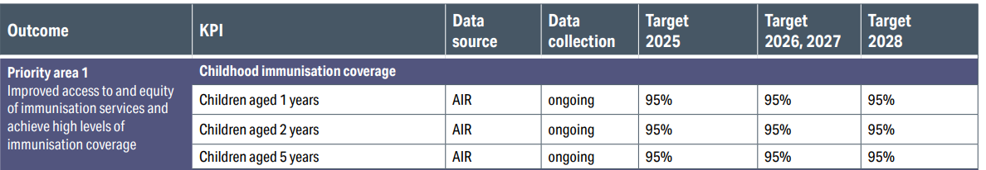
What are the KPIs?
Coverage for each program and indicators of access for priority populations and settings
Notes:
For Priority Area 1, there are x KPIs
Coverage for each program and indicators of access for priority populations and settings
Outcome that we are measuring progress against

Slide 19
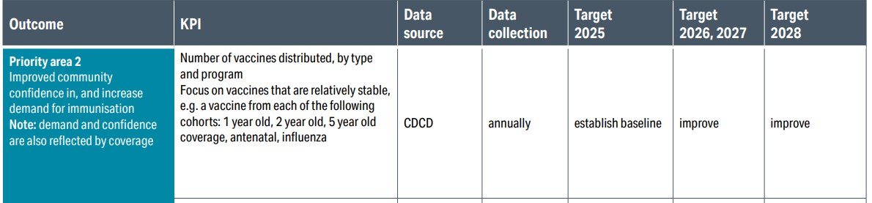
What are the KPIs?
Notes:
Demand for vaccines, and vaccine hesitancy amongst community

Slide 20
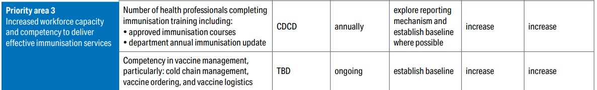
What are the KPIs?
Notes:
Workforce competency against core skills, e.g. cold chain management, proportion of vaccine administration errors

Slide 21
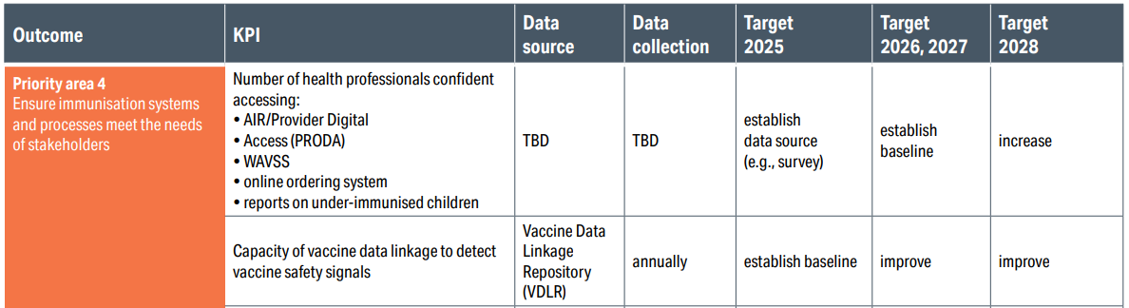
What are the KPIs?
Notes:
System capability and capacity, e.g. ability to detect safety signals, appropriateness of systems (AIR, PRODA etc)

Slide 22
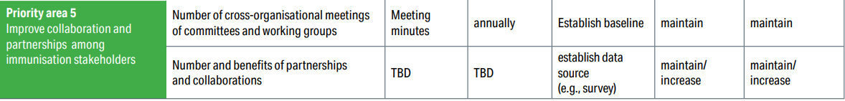
What are the KPIs?
Notes:
Benefit and impact of collaboration across the system

Slide 23
What are the KPIs?

