Slide 1
MenB Vaccine in the NT: Challenges and Opportunities
Heather Parker, Director of Immunisation Policy & Strategy
Northern Territory Centre for Disease Control – NT Health
Notes:
Hello everyone and thanks for inviting me to speak today.
I’d like to start by acknowledging the Traditional Custodians of the various lands on which we are meeting today – for me, beautiful Larrakia Country in the NT - and pay my respects to Elders past, and present, as well as to any Aboriginal and Torres Strait Islander people joining us online today.
My name is Heather Parker, Director of Immunisation Policy and Strategy at the NT Centre for Disease Control.
Today I’ll be sharing our experience rolling out the Meningococcal B Vaccine Blitz Program in the Northern Territory — highlighting both the challenges and opportunities of cross-departmental collaboration, and how we worked to influence and gain buy-in from areas that don’t report directly to us.

Slide 2


NT Men B Vaccine Program
Launched in January 2025 by the NT Government
Eligibility:
  Infants aged 6 weeks to 12 months
  Adolescents in year 9 (14-years-old)
  Catch-up program through 2026 – infants 12 months to 2 years
  - adolescents 15 to 19 years
Financial commitment:
  $1 million in the first 2 years
  $500k ongoing
  Budget for extensive media campaign & purchase of vaccines
  NO BUDGET ALLOCATED FOR ADDITONAL FTE
Notes:
The MenB program was launched in January 2025 as an NT Government election commitment — covering infants, year 9 students, and catch-up cohorts up to 19 years.
While the policy commitment and funding were clear, operationalising this across different service streams quickly revealed a complex network of responsibilities, priorities, and reporting lines.
The CDC’s role focused on policy, program design, and coordination, but the Primary Health Care (PHC) division and Health Promoting School Nurses (HPSNs) were responsible for on-ground delivery through the School-Based Immunisation Program (SBIP) — creating a natural tension around ownership and scope.

Slide 3


NT School-Based Immunisation Program
SBIP overseen by Primary Health Care (PHC) not CDC
Health Promoting School Nurses (HPSN) based in middle schools
PHC guidelines only included years 7 & 9 in the SBIP
Resistance to change: reluctance from HPSN to include years 10-12
Notes:
One of our biggest challenges was that the SBIP, overseen by PHC, not the CDC Immunisation Unit – different reporting lines, only included years 7 and 9.
To reach older adolescents — those at highest MenB risk — we needed to expand into years 10–12, but this was outside the existing PHC guidelines.
We had to work with HPSNs and their managers to advocate for change. Some nurses were supportive, but others questioned the workload, resourcing, and alignment with their existing guideline.
This was a classic case of needing to influence without authority — where persuasion, trust, and shared purpose became our main tools.

Slide 4

The push forward:
CDC Immunisation Unit Steps In
Engaged with NT Health Executive team
Established the Men B Blitz Planning Group
CDC appoints dedicated Blitz project lead
CDC offers administrative and nurse support on Blitz days
Project lead liaises with schools & HPSNs to plan Blitzes
10 out of 15 high schools in Top End Urban commit to Blitz Program
Notes:
To progress, the CDC engaged executive leadership early — securing endorsement from both the NT Health Chief Executive and Department of Education CEO to support the Blitz.
We established a MenB Blitz Planning Group, which helped align communications, logistics, and governance.
A key move was appointing a dedicated project lead to liaise directly with schools and HPSNs — demonstrating that the CDC wasn’t there to direct, but to partner and remove barriers.
This approach built credibility — and within weeks, 10 of 15 high schools in the Top End Urban region signed on to participate.

Slide 5

The journey so far: Successes
2,750 year 10-12 students given Men B Vaccine
Catch-up vaccines given to 750 students
Good engagement from schools & enthusiastic response from parents
CDC identified barriers in SBIP & advocated for HPSN support
Notes:
The Blitz program reached 2,750 year 10–12 students in two rounds offered in Term 3 and Term 4 - an incredible result considering these cohorts weren’t even part of the official SBIP structure.
Catch-ups for other Vaccines identified in round 1 (approx. 80% of students requiring catch-up) & catch-ups offered in round 2 alongside 2nd dose of Men B.
Schools engaged enthusiastically once the logistics and messaging were simplified. Excellent response from parents – incredibly thankful to be informed of program & need for catch-up vaccines.
We also managed to prompt a change to the PHC SBIP guideline that removes specific age groups from the document, instead stating “the (SBIP) is an avenue for school students to receive age appropriate immunisations”
The campaign also helped us identify systemic barriers within the SBIP — things that had been invisible until we started working alongside PHC and school nurses.
Ultimately, we proved that collaboration between divisions can drive innovation when there’s a shared health outcome anchoring the effort

Slide 6

The journey so far: Barriers
Limited participation from other regions
Ongoing difficulties with consent returns
Still not seen as core business by some School Nurses
Poor communication up & down reporting lines
Notes:
But it wasn’t smooth sailing.
Beyond the initial success, other regions were slower to engage — partly due to staff capacity, competing public health priorities, and lack of directive authority.
We also faced low consent return rates – particularly due to the NT relying on paper-based consents - and persistent perceptions among some HPSNs that MenB wasn’t core business.
These challenges highlighted that policy direction alone doesn’t guarantee implementation — relationships and influence matter more than hierarchy.

Slide 7

Influence strategies that worked:
Early and transparent communication
Identify champions
Frame the benefits
Be flexible
Notes:
A few strategies made a real difference:
Early and transparent communication: We shared the “why” — the epidemiological rationale and community value — not just the “what.”
Identify champions: Within PHC, certain nurse leaders became advocates who could influence their peers more effectively than policy emails ever could.
Frame the benefits: We linked the Blitz to shared goals — reducing adolescent disease burden, improving consent systems, fresh eyes to advocate for HPSNs and improvements in the SBIP, and showcasing teamwork between divisions.
Be flexible: We adapted to each school and region’s operational reality instead of expecting one-size-fits-all implementation.
Influence in this context was less about authority and more about co-design, listening, and persistence.

Slide 8

Lessons Learnt:
Identify potential barriers early
Secure executive backing
Map communication channels
Be part of funding negotiations
Notes:
This experience reinforced a few key lessons:
Identify potential barriers early — especially those tied to governance or culture, not just logistics, and plan how to tackle these.
.
Secure executive backing early, but then invest in middle-management and frontline relationships — they make or break delivery.
Map communication channels and decision-makers — influence flows differently across divisions. Ask for clear reporting lines, who sits in what roles, and where the responsibility for communicating plans and decisions sits.
Link funding to collaboration where possible — having a seat at the table during resource discussions helps ensure operational elements are considered for example, will additional FTE/staffing support be required?
And perhaps most importantly — keep the shared purpose visible: preventing disease through immunisation and protecting our community.

Slide 9
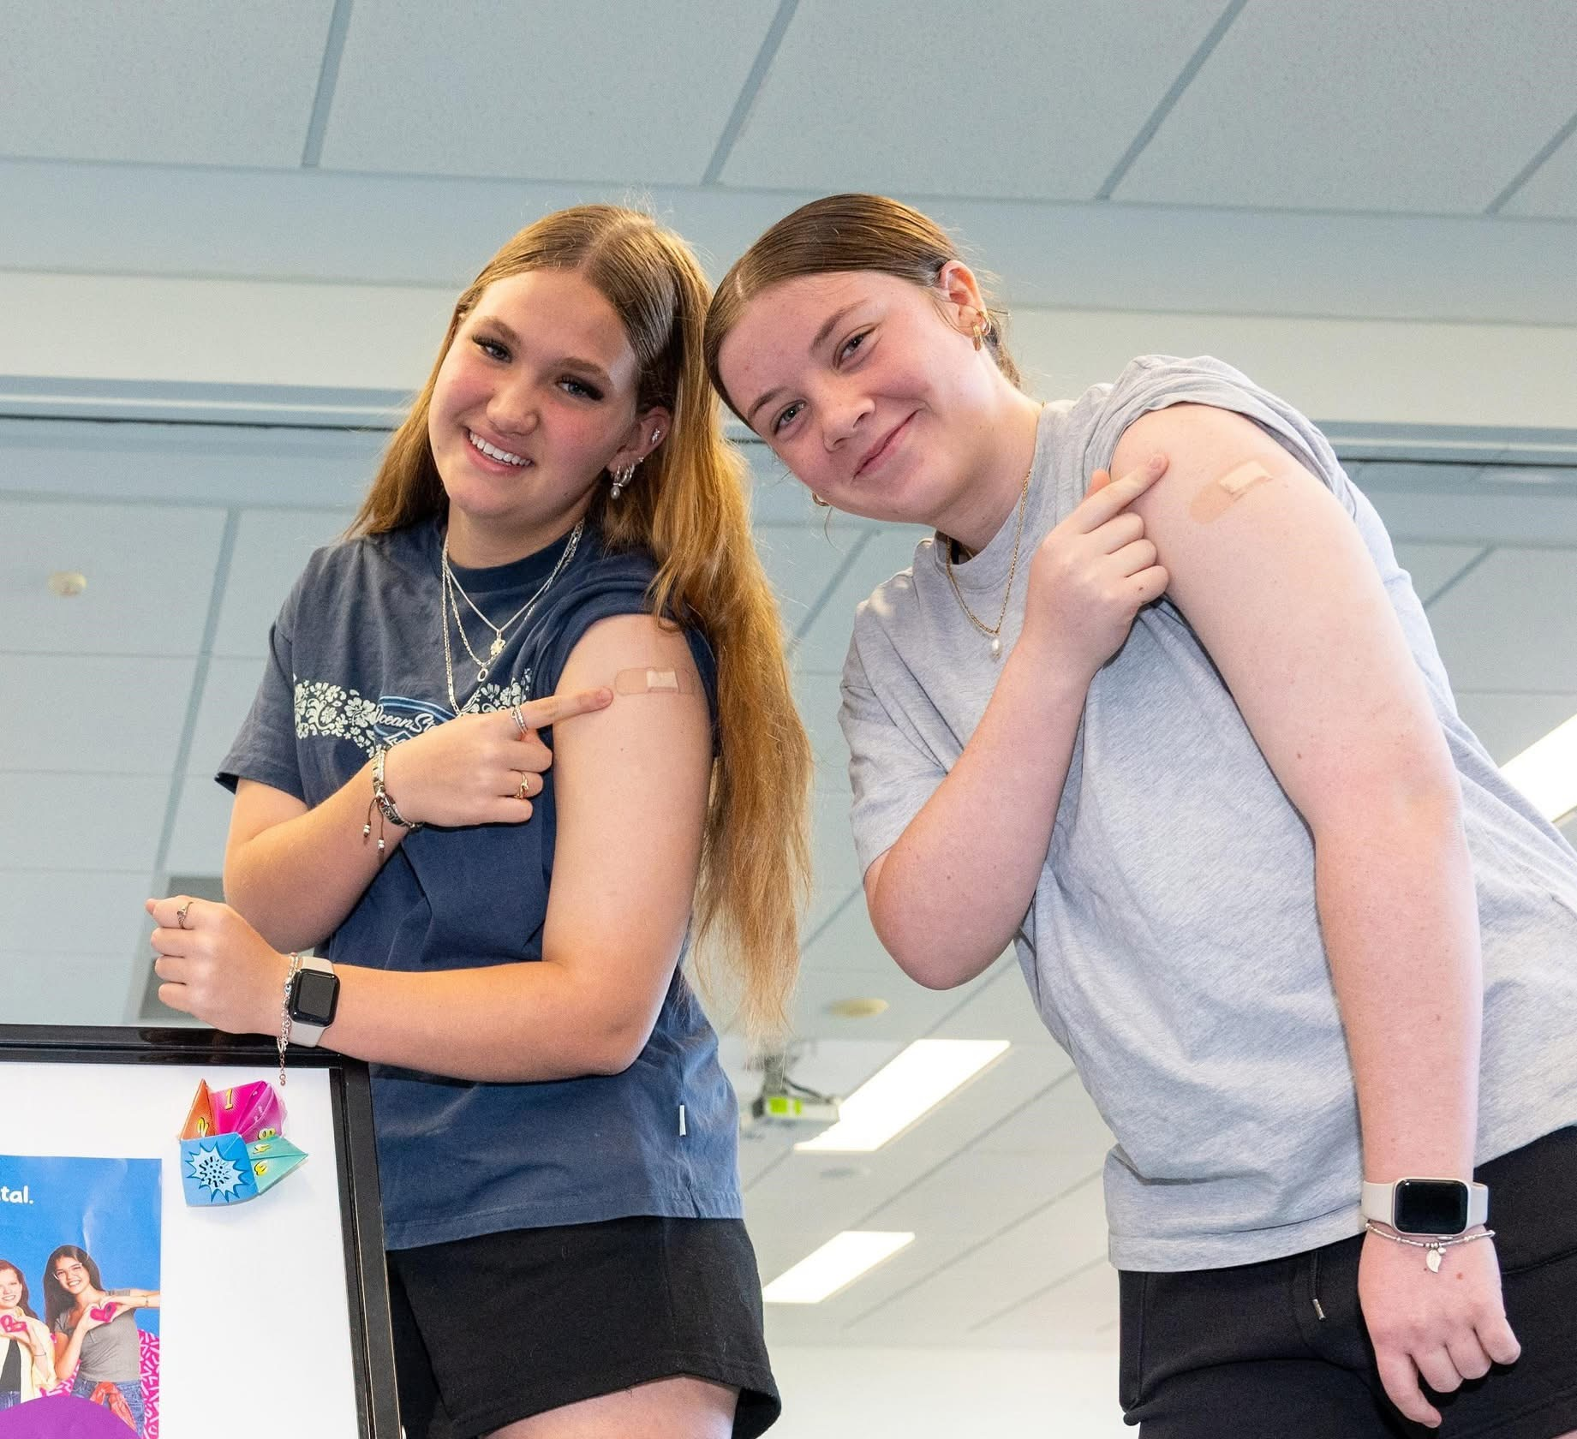
Thank you
Heather Parker
Notes:
In summary, I hope the MenB Blitz has demonstrated the importance of stepping outside traditional silos and approaching collaboration as a negotiated partnership rather than a directive.
Our goal now is to embed these lessons and implement new strategies to support immunisation in schools:
We are driving E-Consent project to boost consent returns
A repot is being drafted on the Blitz program which will include key recommendations such as administrative support for the SBIP, tablets or laptops so AIR records can be checked on vaccine days, and additional nursing staff so the school program can be offered to all students in high school.
Thank you — and I look forward to your questions and hearing how others have navigated similar cross-sector immunisation challenges.

